Slide 1
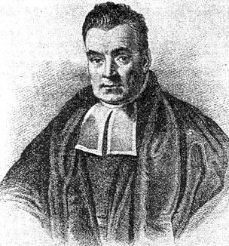
Naïve Bayes Classifier
Dinabandhu Bhandari
Thomas Bayes 1702 -1761

Slide 2
Outline
Background
Probability Basics
Probabilistic Classification
Naïve Bayes
  Principle and Algorithms
  Example: Play Tennis
Relevant Issues
Summary

Slide 3
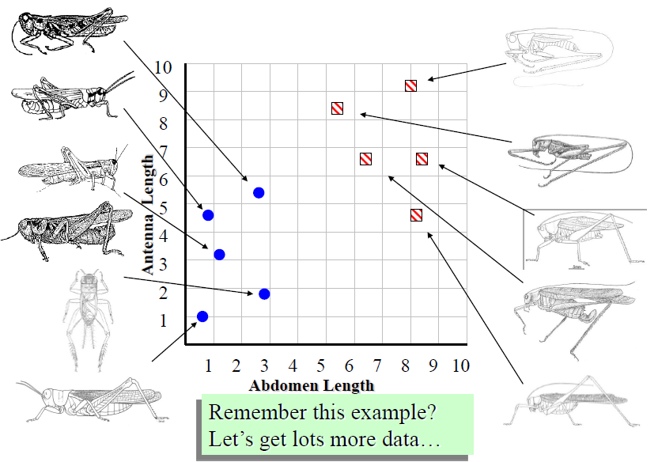
Grasshoppers Katydids

Slide 4
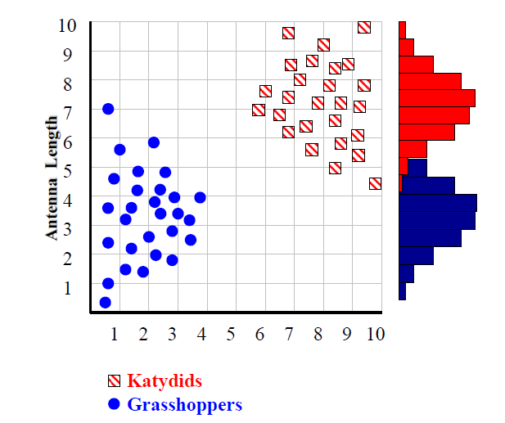
With lot of data, we can build a histogram. Let us build one for “Antenna Length” for now…

Slide 5
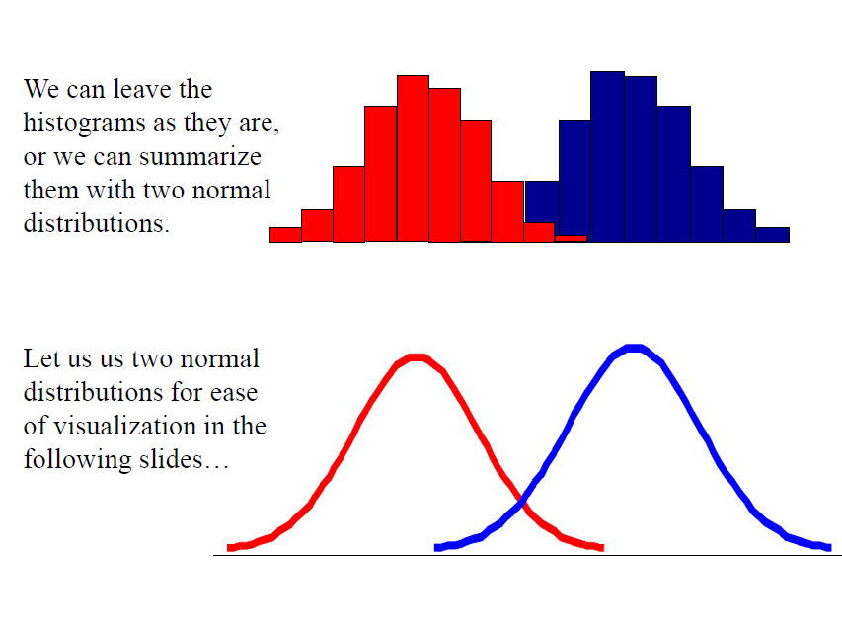

Slide 6
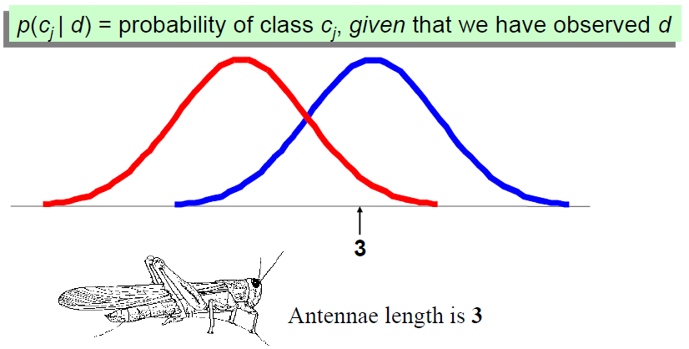
1. We want to classify an insect we have found. Its antennae are 3 units long. How can we classify it?
2. We can just ask ourselves, given the distributions of antennae lengths we have seen, is it more probable that our insect is a Grasshopper or a Katydid.
3. There is a formal way to discuss the most probable classification…

Slide 7
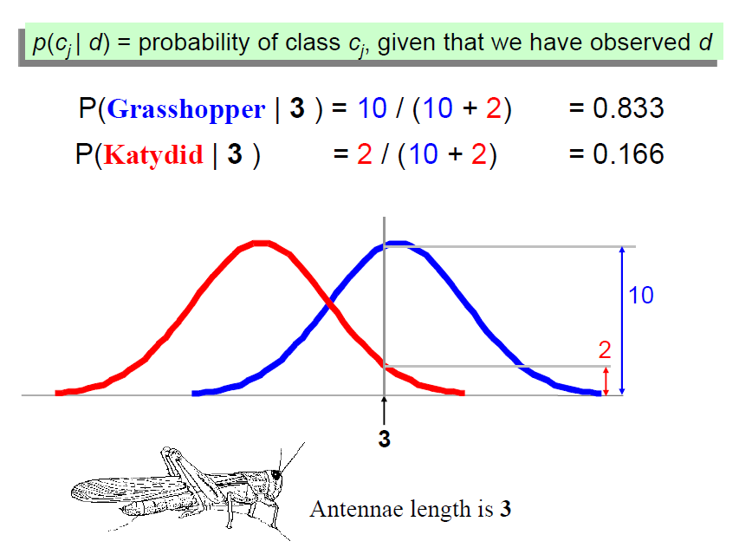

Slide 8
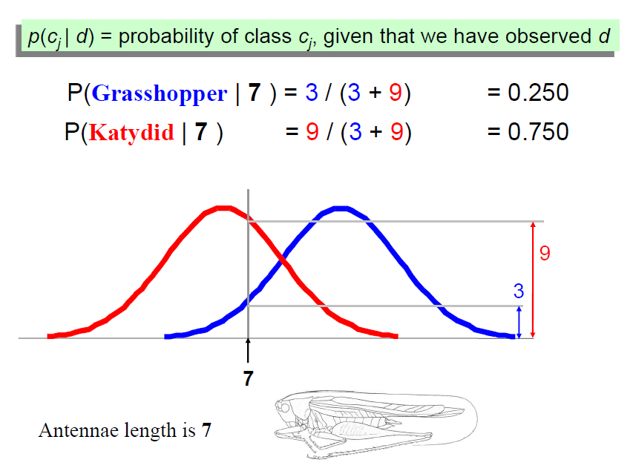

Slide 9
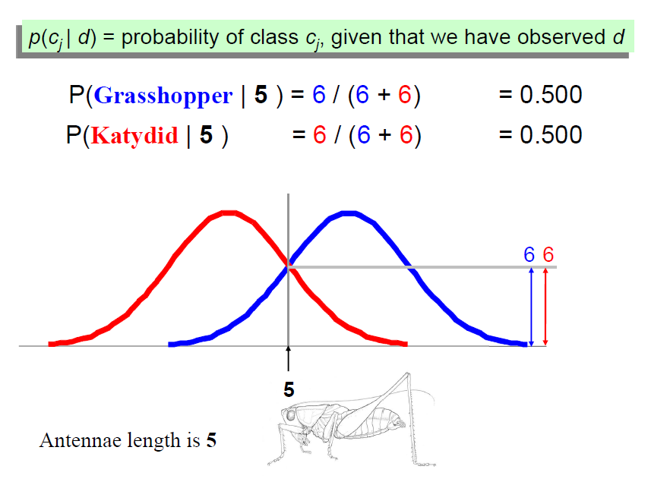

Slide 10
Background
There are three methods to establish a classifier
a) Model a classification rule directly
  Examples: k-NN, decision trees, perceptron, SVM
  b) Model the probability of class memberships given input data
  Example: perceptron with the cross-entropy cost
c) Make a probabilistic model of data within each class
  Examples: naive Bayes, model based classifiers
a) and b) are examples of discriminative classification
c) is an example of generative classification
b) and c) are both examples of probabilistic classification

Slide 11



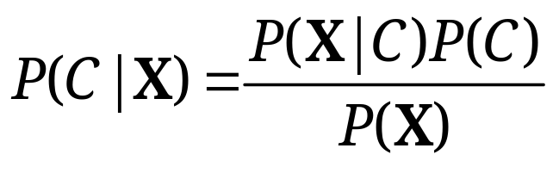
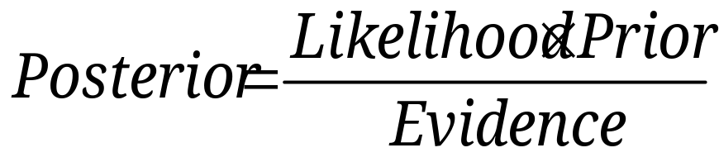
Probability Basics
Prior, conditional and joint probability for random variables
  Prior probability:
  Conditional probability:
  Joint probability:
  Relationship:
  Independence:
Bayesian Rule

Slide 12
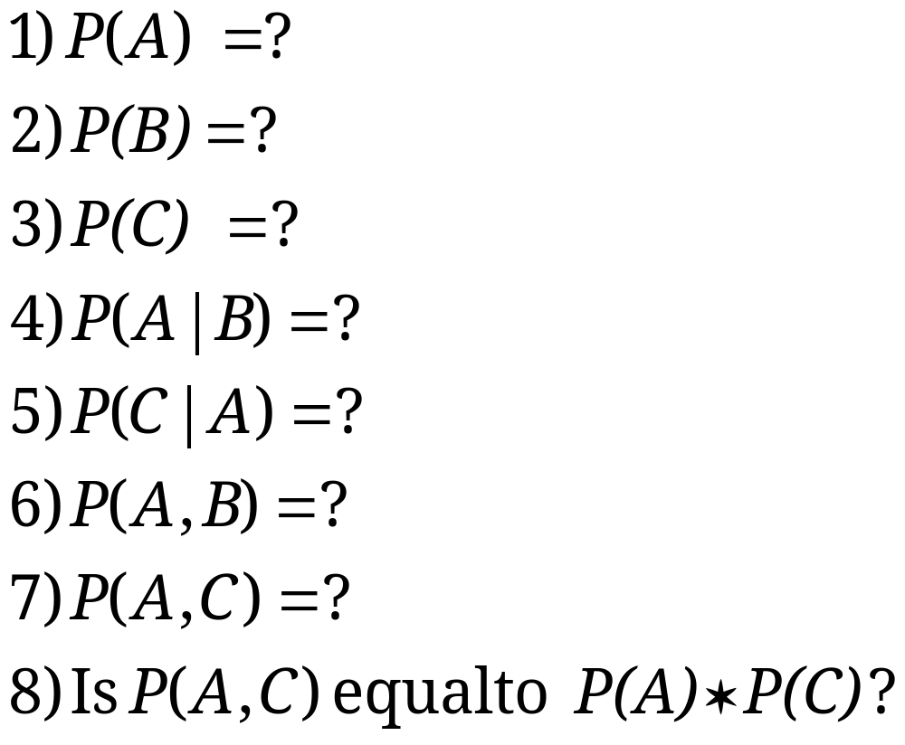
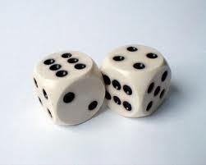
Probability Basics
Quiz: We have two six-sided dice. When they are tolled, it could end up with the following occurance: (A) dice 1 lands on side “3”, (B) dice 2 lands on side “1”, and (C) Two dice sum to eight. Answer the following questions:

Slide 13









Probabilistic Classification
Establishing a probabilistic model for classification
  Discriminative model
Discriminative
Probabilistic Classifier

Slide 14




Probabilistic Classification
Establishing a probabilistic model for classification (cont.)
  Generative model
Generative
Probabilistic Model
for Class 1
Generative
Probabilistic Model
for Class 2
Generative
Probabilistic Model
for Class L

Slide 15
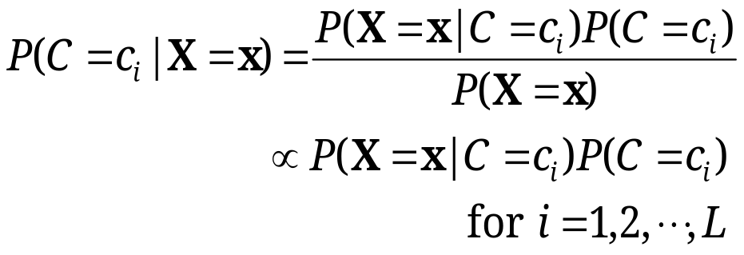
Probabilistic Classification
MAP classification rule
  MAP: Maximum A Posterior
  Assign x to c* if
Generative classification with the MAP rule
  Apply Bayesian rule to convert them into posterior probabilities
  Then apply the MAP rule

Slide 16

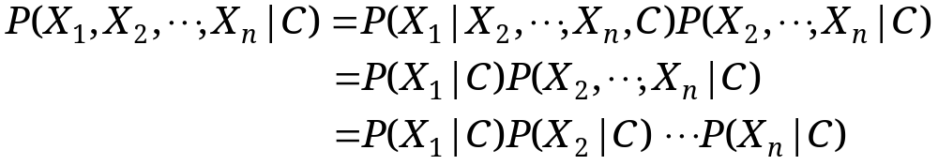
Naïve Bayes
Bayes classification
  Difficulty: learning the joint probability
Naïve Bayes classification
  Assumption that all input features are conditionally independent!
  MAP classification rule: for
Notes:
For a class, the previous generative model can be decomposed by n generative models of a single input.

Slide 17

Example
Example: Play Tennis

Slide 18
Example (learning Phase)
Outlook | Play=Yes | Play=No
Sunny | 2/9 | 3/5
Overcast | 4/9 | 0/5
Rain | 3/9 | 2/5
Temperature | Play=Yes | Play=No
Hot | 2/9 | 2/5
Mild | 4/9 | 2/5
Cool | 3/9 | 1/5
Humidity | Play=Yes | Play=No
High | 3/9 | 4/5
Normal | 6/9 | 1/5
Wind | Play=Yes | Play=No
Strong | 3/9 | 3/5
Weak | 6/9 | 2/5
P(Play=Yes) = 9/14
P(Play=No) = 5/14

Slide 19
Example (Test Phase)
  Given a new instance, predict its label
  x’=(Outlook=Sunny, Temperature=Cool, Humidity=High, Wind=Strong)
  Look up tables achieved in the learning phrase
  Decision making with the MAP rule
P(Outlook=Sunny|Play=Yes) = 2/9
P(Temperature=Cool|Play=Yes) = 3/9
P(Huminity=High|Play=Yes) = 3/9
P(Wind=Strong|Play=Yes) = 3/9
P(Play=Yes) = 9/14
P(Outlook=Sunny|Play=No) = 3/5
P(Temperature=Cool|Play==No) = 1/5
P(Huminity=High|Play=No) = 4/5
P(Wind=Strong|Play=No) = 3/5
P(Play=No) = 5/14
P(Yes|x’) ≈ [P(Sunny|Yes)P(Cool|Yes)P(High|Yes)P(Strong|Yes)]P(Play=Yes) = 0.0053
P(No|x’) ≈ [P(Sunny|No) P(Cool|No)P(High|No)P(Strong|No)]P(Play=No) = 0.0206
Given the fact P(Yes|x’) < P(No|x’), we label x’ to be “No”.

Slide 20
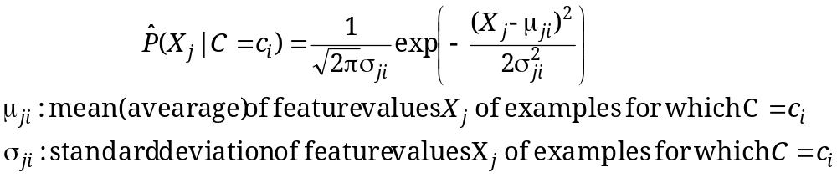




Naïve Bayes
Algorithm: Continuous-valued Features
  Numberless values for a feature
  Conditional probability often modeled with the normal distribution
  Learning Phase:
  Output: normal distributions and
  Test Phase: Given an unknown instance
    Instead of looking-up tables, calculate conditional probabilities with all the normal distributions achieved in the learning phrase
    Apply the MAP rule to make a decision

Slide 21
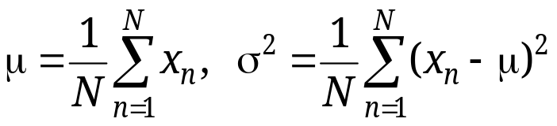
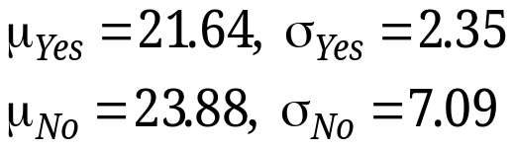
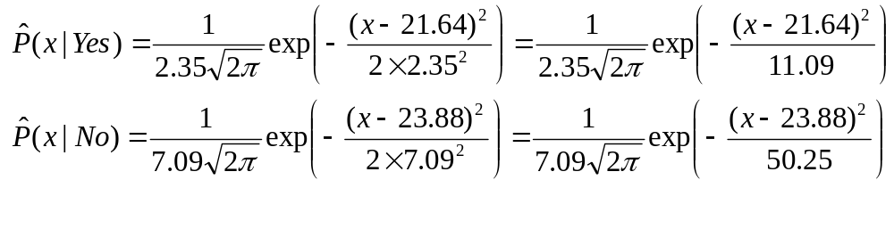
Naïve Bayes
Example: Continuous-valued Features
  Temperature is naturally of continuous value.
  Yes: 25.2, 19.3, 18.5, 21.7, 20.1, 24.3, 22.8, 23.1, 19.8
  No: 27.3, 30.1, 17.4, 29.5, 15.1
  Estimate mean and variance for each class
  Learning Phase: output two Gaussian models for P(temp|C)

Slide 22

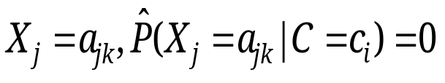
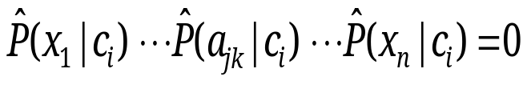
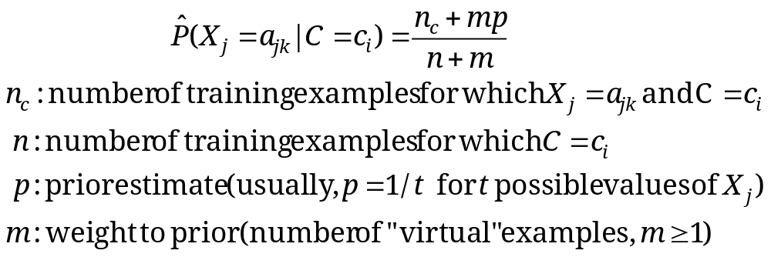
Relevant Issues
Violation of Independence Assumption
  For many real world tasks,
  Nevertheless, naïve Bayes works surprisingly well anyway!
Zero conditional probability Problem
  If no example contains the feature value
  In this circumstance, during test
  For a remedy, conditional probabilities re-estimated with

Slide 23
Summary
Naïve Bayes: the conditional independence assumption
  Training is very easy and fast; just requiring considering each attribute in each class separately
  Test is straightforward; just looking up tables or calculating conditional probabilities with estimated distributions
A popular generative model
  Performance competitive to most of state-of-the-art classifiers even in presence of violating independence assumption
  Many successful applications, e.g., spam mail filtering
  A good candidate of a base learner in ensemble learning

Slide 24
Thank You!!

